Slide 1
This time: constraint satisfaction
- Constraint Satisfaction Problems (CSP)
- Backtracking search for CSPs
- Local search for CSPs

Slide 2
Constraint satisfaction problems
Standard search problem:
state is a “black box” – any data structure that supports successor function, heuristic function, and goal test
CSP:
state is defined by variables Xi with values from domains Di
goal test is a set of constraints specifying allowable combinations of values for subsets of variables
Simple example of a formal representation language
Allows useful general-purpose algorithms with more power than standard search algorithms

Slide 3
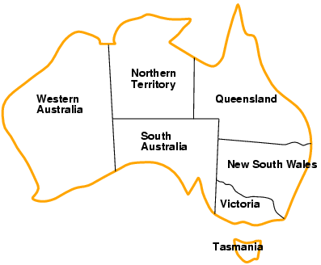
Example: map coloring problem
Variables: WA, NT, Q, NSW, V, SA, T
Domains: D_{i} = {red, green, blue} (one for each variable)
Constraints: C_{i} = <scope, rel > where scope is a tuple of variables and rel is the relation over the values of these variables
E.g., here, adjacent regions must have different colors e.g., WA ≠ NT, or (WA,NT) in {(red,green), (red,blue), (green,red), (green,blue), (blue,red), (blue,green)}

Slide 4
Example: map coloring problem
Assignment: values are given to some or all variables
Consistent (legal) assignment: assigned values do not violate any constraint
Complete assignment: every variable is assigned
Solution to a CSP: a consistent and complete assignment

Slide 5
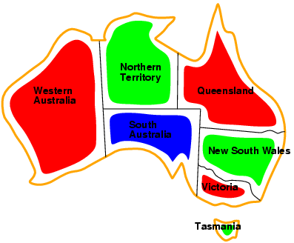
Example: map coloring problem
Solutions are complete and consistent assignments,
e.g., WA = red, NT = green, Q = red, NSW = green, V = red, SA = blue, T = green

Slide 6
Example: map coloring problem
See map coloring applet

Slide 7
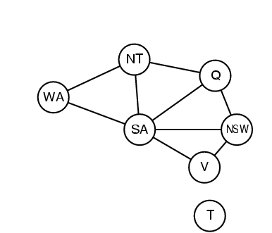
Constraint graph
Binary CSP: each constraint relates two variables
Constraint graph: nodes are variables, arcs are constraints

Slide 8
Varieties of CSPs
Discrete variables
finite domains:
n variables, domain size d → O(d^{n}) complete assignments
e.g., Boolean CSPs, incl. Boolean satisfiability (NP-complete)
infinite domains:
integers, strings, etc.
e.g., job scheduling, variables are start/end days for each job
need a constraint language, e.g., StartJob₁ + 5 ≤ StartJob₃
Continuous variables
e.g., start/end times for Hubble Space Telescope observations
linear constraints solvable in polynomial time by linear programming

Slide 9
Varieties of constraints
Unary constraints involve a single variable,
e.g., SA ≠ green
Binary constraints involve pairs of variables,
e.g., SA ≠ WA
Higher-order (sometimes called global) constraints involve 3 or more variables,
e.g., cryptarithmetic column constraints

Slide 10
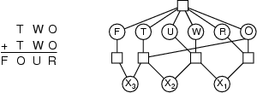
Example: cryptarithmetic
Variables: F T U W R O X₁ X₂ X₃
Domains: {0,1,2,3,4,5,6,7,8,9}
Constraints:
Alldiff (F,T,U,W,R,O)
O + O = R + 10 · X₁
X₁ + W + W = U + 10 · X₂
X₂ + T + T = O + 10 · X₃
X₃ = F, T ≠ 0, F ≠ 0
Constraint hypergraph
Circles: nodes for variable
Squares: hypernodes for n-ary constraints

Slide 11
Real-world CSPs
Assignment problems
e.g., who teaches what class
Timetabling problems
e.g., which class is offered when and where?
Transportation scheduling
Factory scheduling
Notice that many real-world problems involve real-valued variables

Slide 12
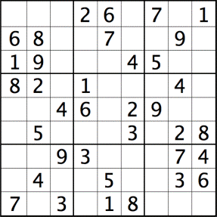
Example: sudoku
?
Variables: each square (81 variables)
Domains: [1 .. 9]
Constraints: each column, each row, and each of the nine 3×3 sub-grids that compose the grid
contain all of the digits from 1 to 9

Slide 13
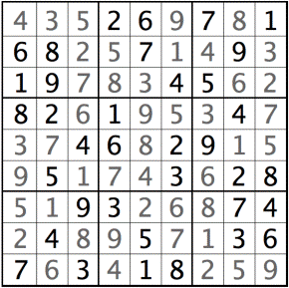
Example: sudoku
Variables: each square (81 variables)
Domains: [1 .. 9]
Constraints: each column, each row, and each of the nine 3×3 sub-grids that compose the grid
contain all of the digits from 1 to 9

Slide 14
Formulation as a search problem
Let's start with the straightforward approach, then fix it
States are defined by the values assigned so far
Initial state: the empty assignment { }
Successor function: assign a value to an unassigned variable that does not conflict with current assignment
→ fail if no legal assignments
Goal test: the current assignment is complete
This is the same for all CSPs
Every solution appears at depth n with n variables → use depth-first search
Path is irrelevant, so can be discarded
b = (n - l )d at depth l, hence n! · d^{n} leaves

Slide 15
Backtracking search
Variable assignments are commutative, i.e.,
[ WA = red then NT = green ] same as [ NT = green then WA = red ]
Only need to consider assignments to a single variable at each node
→ b = d and there are d^{n} leaves
Depth-first search for CSPs with single-variable assignments is called backtracking search
Backtracking search is the basic uninformed algorithm for CSPs
Can solve n-queens for n ≈ 25

Slide 16
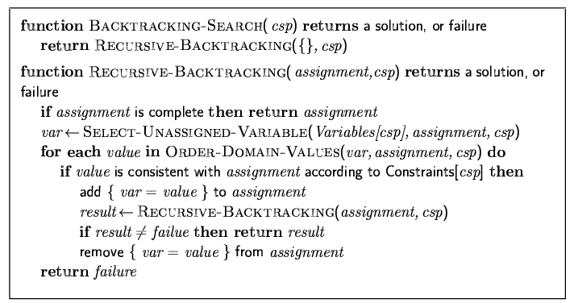
Backtracking search

Slide 17

Backtracking example

Slide 18
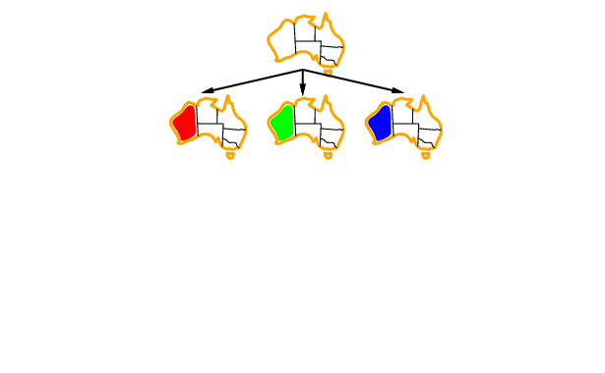
Backtracking example

Slide 19
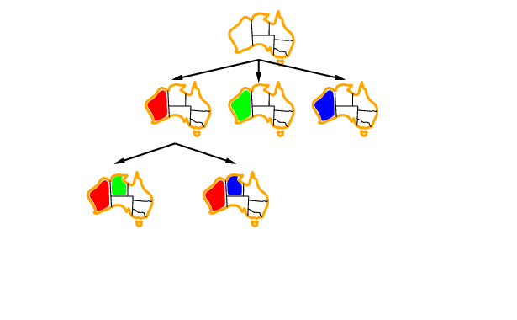
Backtracking example

Slide 20
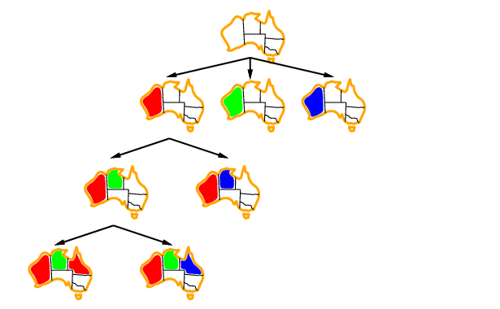
Backtracking example

Slide 21
Improving backtracking efficiency
General-purpose methods can give huge gains in speed (like using heuristics in informed search):
Which variable should be assigned next?
In what order should its values be tried?
Can we detect inevitable failure early?

Slide 22

Most constrained variable
Most constrained variable:
choose the variable with the fewest legal values
a.k.a. minimum remaining values (MRV) heuristic

Slide 23

Most constraining variable
Tie-breaker among most constrained variables
Most constraining variable:
choose the variable with the most constraints on remaining variables
also known as the degree heuristic

Slide 24
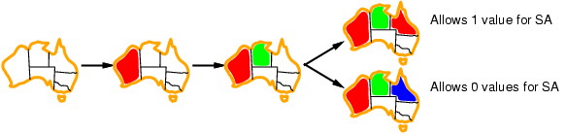
Least constraining value
Given a variable, choose the least constraining value:
the one that rules out the fewest values in the remaining variables
Combining these heuristics makes 1000 queens feasible

Slide 25
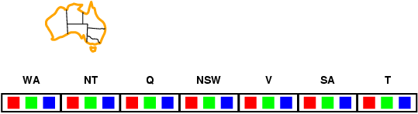
Forward checking
Idea:
Keep track of remaining legal values for unassigned variables (inference step)
Terminate search when any variable has no legal values

Slide 26
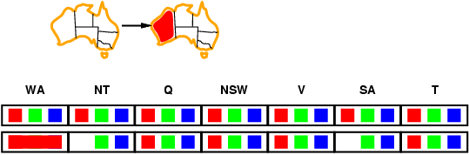
Forward checking
Idea:
Keep track of remaining legal values for unassigned variables (inference step)
Terminate search when any variable has no legal values

Slide 27
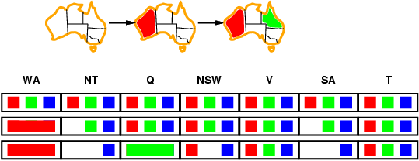
Forward checking
Idea:
Keep track of remaining legal values for unassigned variables
Terminate search when any variable has no legal values

Slide 28
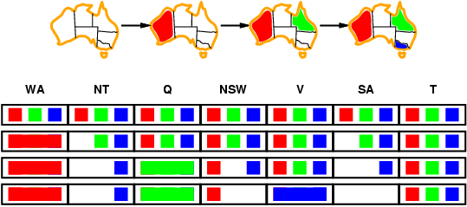
Forward checking
Idea:
Keep track of remaining legal values for unassigned variables
Terminate search when any variable has no legal values

Slide 29
Constraint propagation
Forward checking propagates information from assigned to unassigned variables, but doesn't provide early detection for all failures:
NT and SA cannot both be blue!
Constraint propagation repeatedly enforces constraints locally

Slide 30
Node and Arc consistency
A single variable is node-consistent if all the values in its domain satisfy the variable’s unary constraints
A variable is arc-consistent if every value in its domain satisfies the binary constraints
i.e., Xi arc-consistent with Xj if for every value in Di there exists a value in Dj that satisfies the binary constraints on arc (Xi, Xj)
A network is arc-consistent if every variable is arc-consistent with every other variable.
Arc-consistency algorithms: reduce domains of some variables to achieve network arc-consistency.

Slide 31
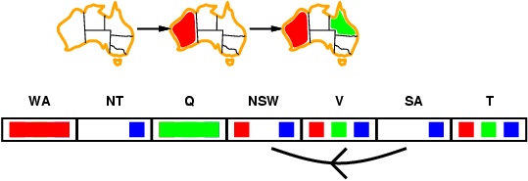
Arc consistency
Simplest form of propagation makes each arc consistent
X →Y is consistent iff
for every value x of X there is some allowed y

Slide 32
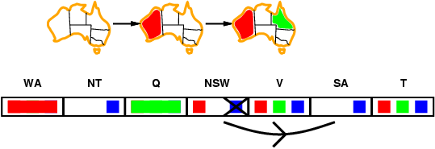
Arc consistency
Simplest form of propagation makes each arc consistent
X →Y is consistent iff
for every value x of X there is some allowed y

Slide 33
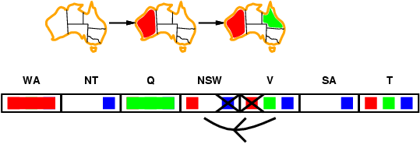
Arc consistency
Simplest form of propagation makes each arc consistent
X →Y is consistent iff
for every value x of X there is some allowed y
If X loses a value, neighbors of X need to be rechecked

Slide 34
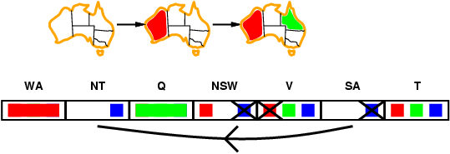
Arc consistency
Simplest form of propagation makes each arc consistent
X →Y is consistent iff
for every value x of X there is some allowed y
If X loses a value, neighbors of X need to be rechecked
Arc consistency detects failure earlier than forward checking
After running AC-3, either every arc is arc-consistent or some variable has empty domain, indicating the CSP cannot be solved.
Can be run as a preprocessor or after each assignment

Slide 35
Arc consistency algorithm AC-3
Start with a queue that contains all arcs
Pop one arc (Xi, Xj) and make Xi arc-consistent with respect to Xj
If Di was not changed, continue to next arc,
Otherwise, Di was revised (domain was reduced), so need to check all arcs connected to Xi again: add all connected arcs (Xk, Xi) to the queue. (this is because the reduction in Di may yield further reductions in Dk)
If Di is revised to empty, then the CSP problem has no solution.

Slide 36
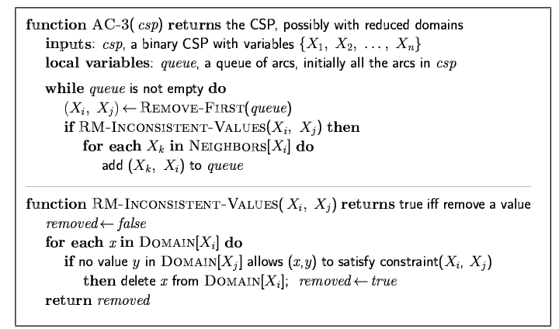
Arc consistency algorithm AC-3
Time complexity: ? (n variables, d values)

Slide 37
Arc consistency algorithm AC-3
Time complexity: O(n²d³) (n variables, d values)
(each arc can be queued only d times, n² arcs (at most), checking one arc is O(d²))

Slide 38
Local search for CSPs
Hill-climbing, simulated annealing typically work with "complete" states, i.e., all variables assigned
To apply to CSPs:
allow states with unsatisfied constraints
operators reassign variable values
Variable selection: randomly select any conflicted variable
Value selection by min-conflicts heuristic:
choose value that violates the fewest constraints
i.e., hill-climb with h(n) = total number of violated constraints

Slide 39
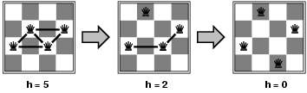
Example: 4-Queens
States: 4 queens in 4 columns (4⁴ = 256 states)
Actions: move queen in column
Goal test: no attacks
Evaluation: h(n) = number of attacks
Given random initial state, can solve n-queens in almost constant time for arbitrary n with high probability (e.g., n = 10,000,000)

Slide 40
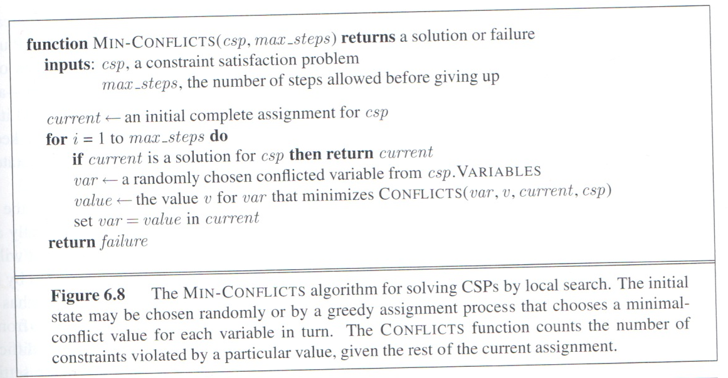
Example: 4-Queens

Slide 41
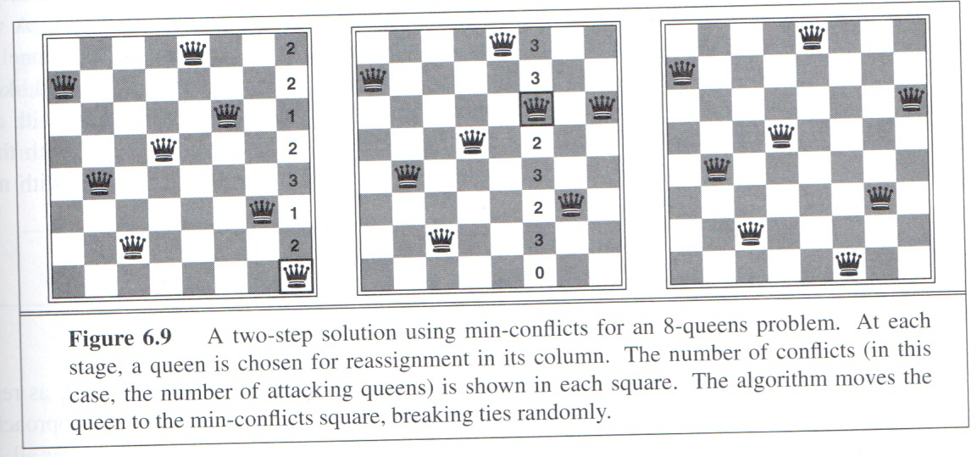
Example: 4-Queens

Slide 42
Summary
CSPs are a special kind of problem:
states defined by values of a fixed set of variables
goal test defined by constraints on variable values
Backtracking = depth-first search with one variable assigned per node
Variable ordering and value selection heuristics help significantly
Forward checking prevents assignments that guarantee later failure
Constraint propagation (e.g., arc consistency) does additional work to constrain values and detect inconsistencies
Iterative min-conflicts is usually effective in practice

